Slide 1

Credit Card Fraud Detection
Tejaswini Singh Chauhan
Uday Pratap Singh​
Luvkush Sharma
Dheeraj Sharma
Mohit Sharma

Slide 2
Table Of Content
Introduction.
Problem Statement.
Objective.
Working.
Conclusion.

Slide 3
Introduction
Credit card fraud detection is the process of identifying and preventing fraudulent activities associated with credit card transactions. With the increasing use of credit cards for online and offline purchases, credit card fraud has become a significant concern for individuals, businesses, and financial institutions. Detecting credit card fraud requires sophisticated techniques and technologies to identify suspicious activities and patterns that may indicate fraudulent behavior.

Slide 4
Problem Statement
The problem statement in credit card fraud detection involves developing a system or algorithm that can accurately detect fraudulent transactions and prevent them from occurring, by analyzing transaction data using machine learning algorithms. The system should be able to flag suspicious transactions in real-time while minimizing false positives, and be efficient and scalable to handle the large volume of transactions processed by credit card companies. The challenge is to identify new patterns and anomalies that indicate fraudulent activity, as fraudsters continually develop new techniques to evade detection.

Slide 5
Objective
The objective of credit card fraud detection is to identify and prevent fraudulent transactions made using credit or debit cards. Credit card fraud occurs when someone steals a credit card or its details, such as the cardholder's name, credit card number, and expiration date, and uses it to make unauthorized purchases or withdraw money from an account.
Identify and prevent fraudulent transactions in real-time.
Minimize financial losses.
Improve customer trust.
Enhance regulatory compliance.

Slide 6
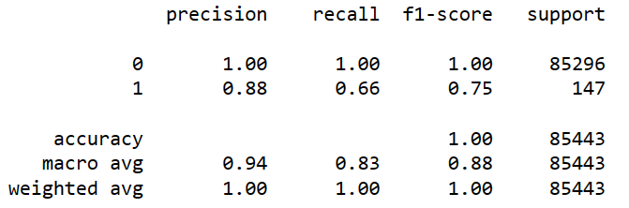
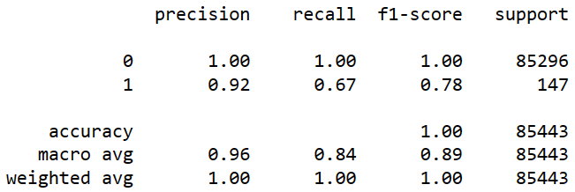
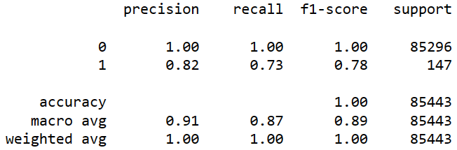
Training of models
Logistic Regression
Accuracy : 99.92626663389628
Decision Tree
Accuracy : 99.92743700478681
Random Forest
Accuracy : 99.93328885923948

Slide 7
Imbalanced dataset
The given dataset is highly imbalanced as:
Not Frauds are 99.83 % of the dataset
Frauds 0.17 % of the dataset

Slide 8
Techniques Used to handle the imbalanced data
Undersampling
Oversampling
SMOTE
ADASYN

Slide 9
WORKING after undersampling

Slide 10
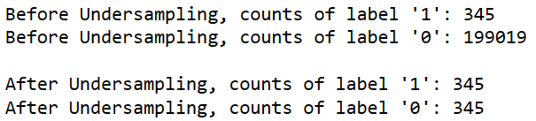
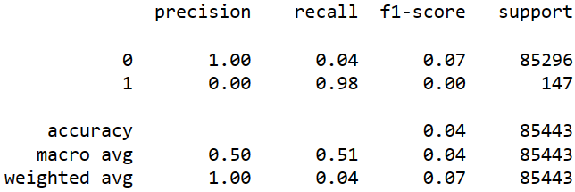
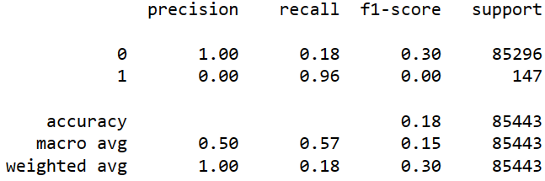
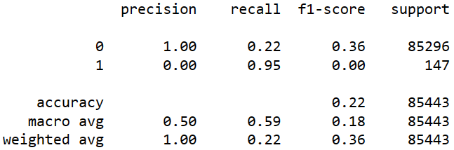
Undersampling
Random Forest
Accuracy : 3.7241201736830405
Logistic Regression
Accuracy : 17.741652329623257
Decision Tree
Accuracy : 21.976054211579648

Slide 11
WORKING after Oversampling

Slide 12
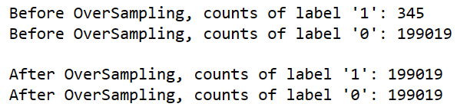
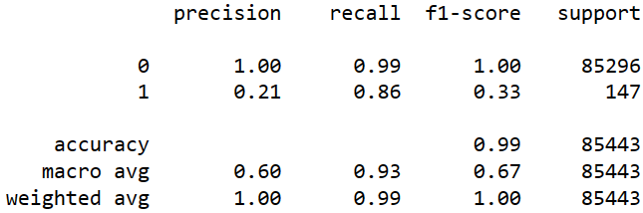
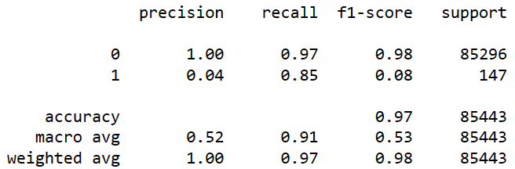
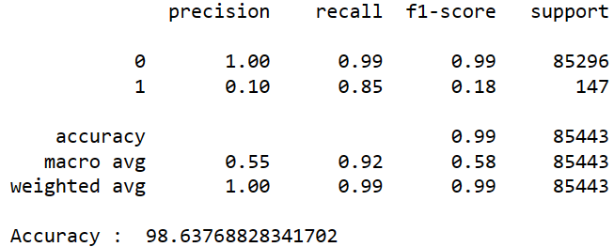
SMOTE
Random Forest
Accuracy : 99.4113034420608
Logistic Regression
Accuracy : 96.8025467270578
Decision Tree
Accuracy : 98.63768828341702

Slide 13
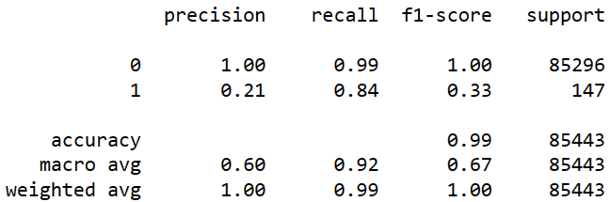
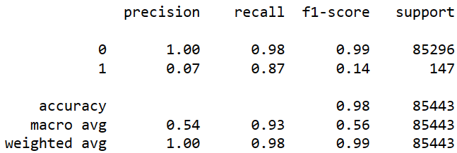
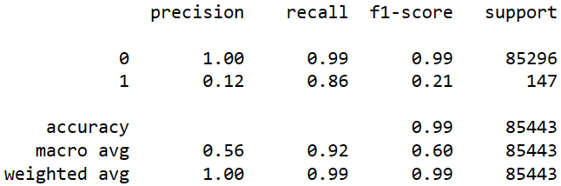
Adasyn
Random Forest
Accuracy : 99.42066640918506
Logistic Regression
Accuracy : 98.08527322308439
Decision Tree
Accuracy : 98.86591060707138

Slide 14
Conclusion
Adasyn is the best balancing technique that can be used to balance our imbalanced data.
Random Forest is the best classification technique to classify the frauds and no fraud cases.
Overall, credit card fraud detection is an ongoing challenge that requires constant innovation and improvement to stay ahead of fraudsters' evolving tactics. By developing effective fraud detection systems, we can help protect consumers and financial institutions from the devastating consequences of credit card fraud.

Slide 15
THANK YOU

